Slide 1
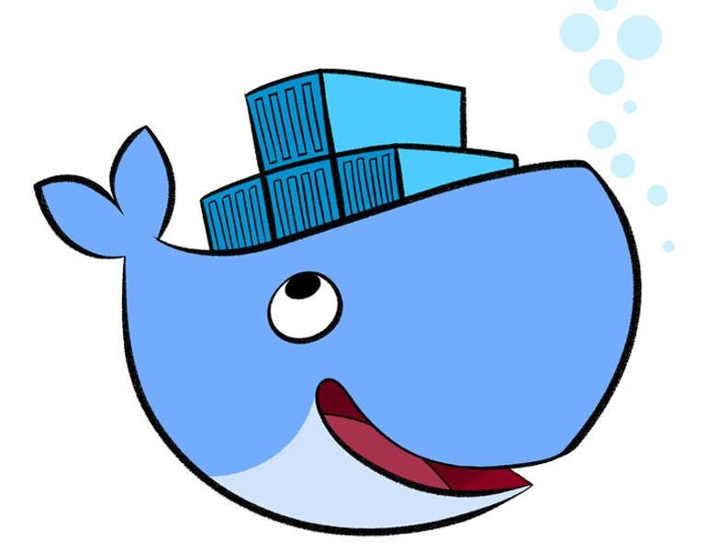
Docker Brown Bag
Containerize your excitement!

Slide 2
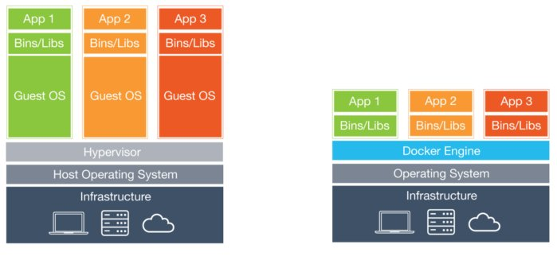
WHAT IS A CONTAINER?
Self-contained execution environments—with their own, isolated CPU, memory, block I/O, and network resources
Share the kernel of the host operating system which means we don’t need complete copies of the guest OS per container – saves disk space!
Sandbox for processes. Normal use case - one process per container
Cool video - https://www.youtube.com/watch?v=EnJ7qX9fkcU

Slide 3
Containers and docker
Docker isn’t containers
Docker (the open source project) has made containers easy
Docker (the commercial company) has tried to monetise this with products such as Docker EE and Docker Swarm
Google’s Kubernetes winning the ‘war’ on container orchestration.
Notes:
Future of Docker Inc?

Slide 4
IMAGES
An immutable representation of a container
Images are layered
E.g. Scratch -> Ubuntu -> Nginx -> MyFirstWebsite
Can share images on host. Only need 1 copy of a particular layer.
Great for versioning, upgrading Nginx is just updated the parent image specified
Notes:
Makes updating your infrastructure like releasing a code version

Slide 5
DOCKERFILE
FROM – specifies the parent image
WORKDIR – set the working directory on the container filesystem
RUN – creates layer containing the results of the run command.
Each RUN is its own layer
Be careful on the amount of layers – more layers = more disk space
Be careful of the cache – always run apt-get update && apt-get install together!!
ADD or COPY – transfer files onto the filesystem of the container
EXPOSE – specifies which ports the container listens on
Note, does not actually make ports accessible on running container
CMD – the command for the container to run (also ENTRYPOINT, or both can be used together)
See docs for other commands
Notes:
https://docs.docker.com/engine/userguide/eng-image/dockerfile_best-practices
https://github.com/karlatkinson/docker-hello-world
https://github.com/nginxinc/docker-nginx/blob/master/stable/stretch/Dockerfile

Slide 6
DOCKER BUILD & RUN
docker build -t karlatkinson/hello-world-website:latest .
docker run -p 5000:80 -d karlatkinson/hello-world-website:latest
Can control the specifications of the container to run, cpu, memory, networking, volumes etc
docker ps
docker logs
Notes:
Demo building.
Show how faster once has initial layers
Run container
Show other commands

Slide 7
DOCKER REGISTRY
Remote location for docker images
Can use docker hub, ecr, host your own….
docker images
docker push karlatkinson/hello-world-website:latest
docker pull karlatkinson/hello-world-website:latest
Notes:
Now have locally, how do we run elsewhere?
Push to docker hub
https://hub.docker.com/u/karlatkinson/
Talk about ECR?

Slide 8
DOCKER MULTI-STAGE BUILDS
Keep your runtime images small and free from build dependencies
Example, websites that require npm, webpack etc
COPY --from my-build-container

Slide 9
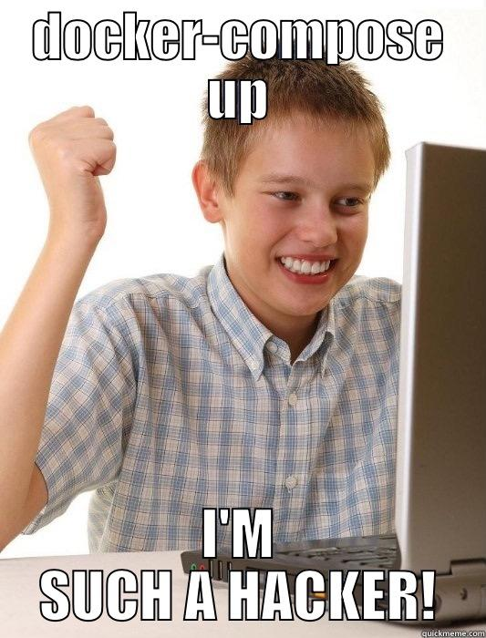
Docker COMpose
Makes complex run commands easy
Run multiple containers as a ‘service’
docker-compose.yml
docker-compose up -d
docker-compose down
docker-compose up --scale app=3
Good for simple stuff or dev, not really a production solution
Notes:
Compose up
Show scaling

Slide 10

LOGGING AND OTHER STUFF
Log to STDOUT
Can then push logs elsewhere using tools such as logspout
https://docs.docker.com/config/containers/logging/configure/
https://12factor.net/
Notes:
awslogs

Slide 11
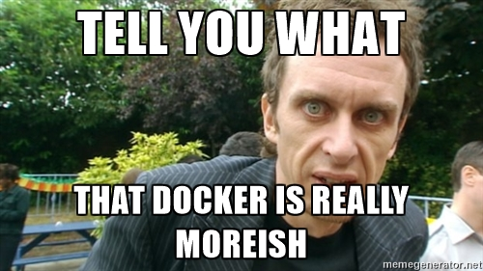
WHY SHOULD I USE CONTAINERS?
Run anywhere – The container image you run on your dev machine is the same you run in production, regardless of OS or hardware
Consistent environment – Each container has a single purpose and we don’t need to worry about the dependencies of other containers
Isolation – Containers run in sandboxed environment on the host OS. One container cannot access another unless we allow it.
Notes:
Talk about serverless?
Slow to keep up with frameworks. Subset of languages. Not in control of OS.

